Slide 1

Network Infrastructure Services Utility
Team Members:
Aayush Patel
Ricky Resendes
Ryan Scott
Dean Smith
Affiliation:
University of Massachusetts Dartmouth
Clients from Naval undersea warfare center division newport:
Nathan Valm
Daniel White

Slide 2

PROJECT BACKGROUND

Slide 3

PROJECT OVERVIEW
Purpose: Product aims to increase workforce efficiency by automating monotonous tasks.
The project will consist of a software utility that will automate various network services
A web application running 24/7 on a System Management Server on the base will host the network infrastructure services

Slide 4
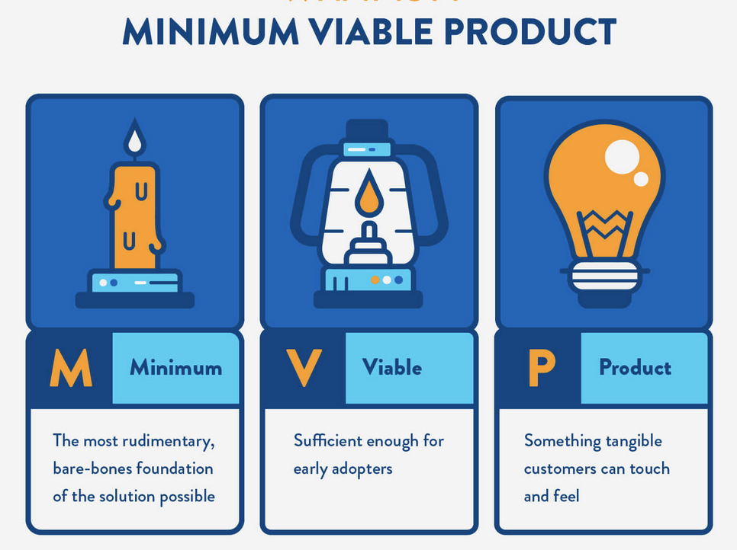
MVP ABSTRACT
3)
Web Application
User Friendly Interface
Displays The Network Diagram
Hosts all the requested Network Infrastructure Services
Responsible for scanning all the devices on the network
Gathered data formatted into a JSON file
JSON file consists of: Device Number, IP address, MAC address, Device Status(online/offline)

Slide 5

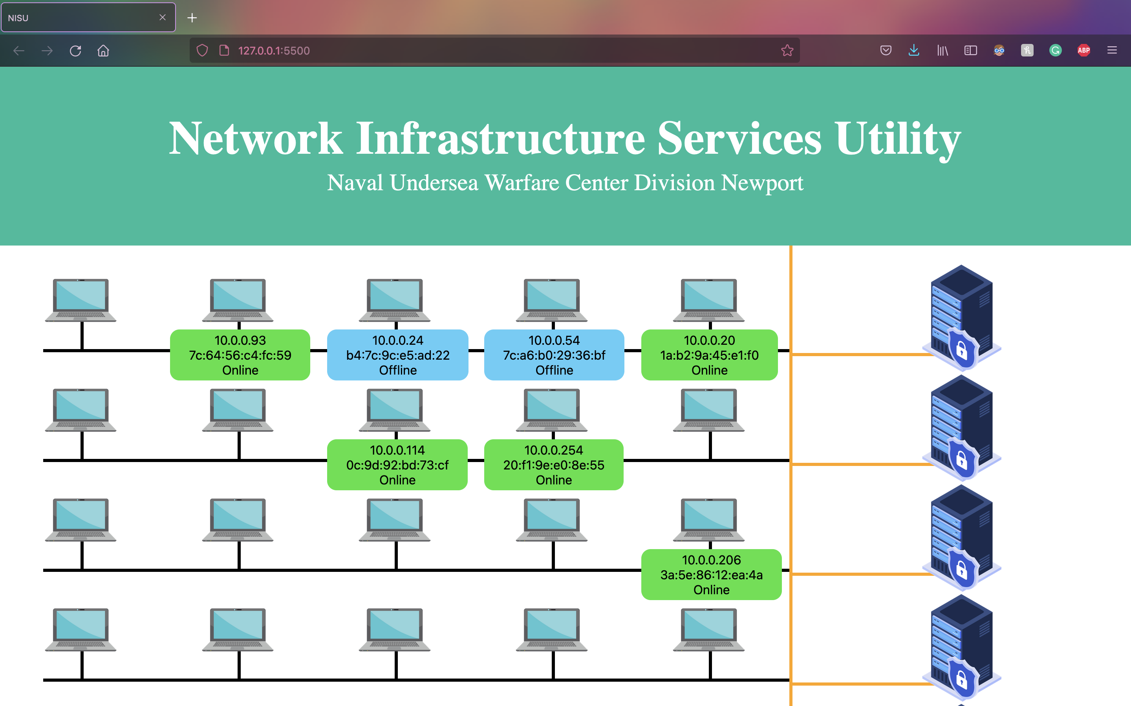



Why the Product Built So Far classifies as MVP ?

Slide 6
BACK END

Slide 7
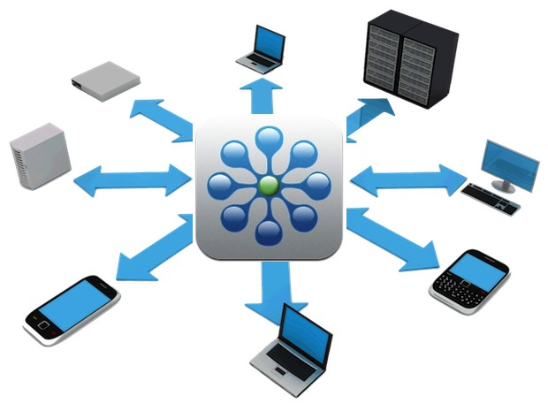
NETWORK SCANNER
Utilizes arping() to scan the network
Scan starts from the IP Address of the current default gateway
Dumps the scan into a text-file to be utilized by dataConversion.py

Slide 8
DATA CONVERSION
Opens the text-file and scans through each new line
Each line scanned is a new device, which includes the MAC Address and IP Address
Information get stored into a Python Dictionary and then dumped into a JSON

Slide 9

ONLINE DETECTION
Grabs two JSON files(MASTER.json and REPEAT.json) and loops through to check for comparable devices.
If the device exists on both files, then the device is online
If a new device is discovered on REPEAT.json, append the new device onto MASTER.json

Slide 10
PACKAGE INSTALLER
Calls pip's command-line interface through subprocess()
Pip is used to install certain python packages
Responsible for installing certain python packages, such as:
scapy
virtualenv

Slide 11
BACKEND CONTROL SCRIPT (BASH SCRIPT)
Responsible for running all python scripts in order and executing what is necessary
Checks to make sure the virtual environment is running and that all Python packages are installed
If packages aren't installed, execute packageinstaller.py

Slide 12

FRONT END

Slide 13


FILE READER
INDEX.JS: Responsible for reading the contents of the "Master.json" file
"readData" uses the JSON.parse() method
JSON.parse() utilized to differentiate:
Device Number
IP address
MAC address
Status(Online/Offline)
The "renderDevices" function renders the icons
The "toggleView" function toggles the attribute bubble when clicked on

Slide 14
HTML
DISPLAYING THE WEBPAGE
CSS
Responsible for displaying:
Layout for the Network
Visuals(Colors, node, Fonts, header)
Responsible for displaying:
Webpage on a browser
Connecting Nodes
Icons for Devices/Servers/Switches

Slide 15









METHODS & TOOLS
Back-end
Front-end
Communication

Slide 16
Demo
https://vimeo.com/650997092

